Slide 1
FILE ORGANIZATION AND
INDEXING

Slide 2
File Organization
It is a method of arranging data on secondary storage devices and addressing them such that it facilitates storage and read/write operations by user.
A record is a collection of logically related data items.
A file is a collection of related sequence of records.

Slide 3
Indexing
Indexes are used to quickly locate data without having to search every row in a database table every time said table is accessed.
Indexes can be created using one or more columns of a database table, providing the basis for both rapid random lookups and efficient access of ordered records.

Slide 4
The Index Table
The Index Table contains a search key and a pointer.
A search key is an attribute or a set of attributes used to look up the records in a file.
Pointer contains address where the record is stored in memory.

Slide 5
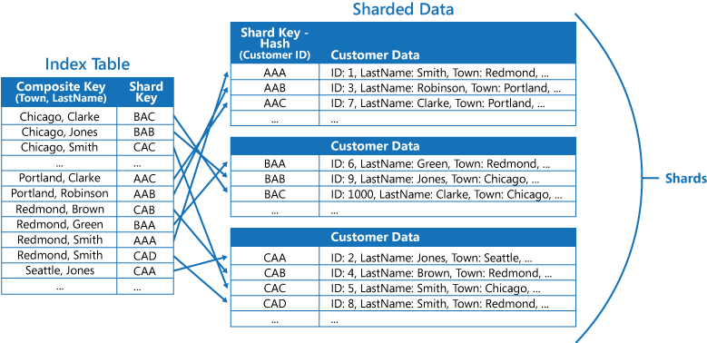
Structure of Index Table

Slide 6
Use of an Index
An Index is a data structure that is added to a file to provide faster access to the data.
It reduces the number of records that the DBMS has to check.

Slide 7
Example
Select * from student where rollno=101
This searches for the whole table row by row to findout the record.
But indexing helps us to findout the record easily.

Slide 8
Creating an index
Create index <index-name> on <table-name> (col-name ASC/DESC)
Example :
Create Index index1 on student (Rollno ASC)

Slide 9
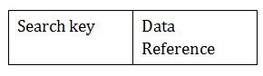
Index Structure
The first column of the database is the search key that contains a copy of the primary key or candidate key of the table.
The second column of the database is the data reference.

Slide 10
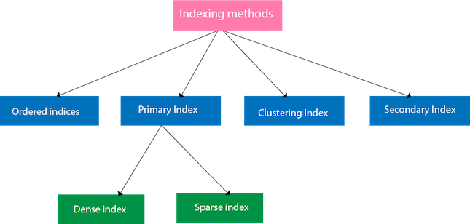
Types of Index

Slide 11
Ordered Indices
The indices are usually sorted to make searching faster. The indices which are sorted are known as ordered indices.
Example: Suppose we have an employee table with thousands of record and each of which is 10 bytes long. If their IDs start with 1, 2, 3....and so on and we have to search student with ID-543.
In the case of a database with no index, we have to search the disk block from starting till it reaches 543. The DBMS will read the record after reading 543*10=5430 bytes.
In the case of an index, we will search using indexes and the DBMS will read the record after reading 542*2= 1084 bytes which are very less compared to the previous case.

Slide 12
Primary Index
If the index is created on the basis of the primary key of the table, then it is known as primary indexing. These primary keys are unique to each record and contain 1:1 relation between the records.
As primary keys are stored in sorted order, the performance of the searching operation is quite efficient.
The primary index can be classified into two types: Dense index and Sparse index.

Slide 13
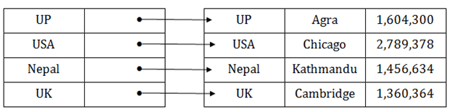
Dense Index

Slide 14
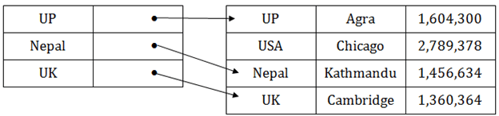
Sparse Index

Slide 15
Clustering Index
A clustered index can be defined as an ordered data file. Sometimes the index is created on non-primary key columns which may not be unique for each record.
In this case, to identify the record faster, we will group two or more columns to get the unique value and create index out of them. This method is called a clustering index.
The records which have similar characteristics are grouped, and indexes are created for these group.

Slide 16
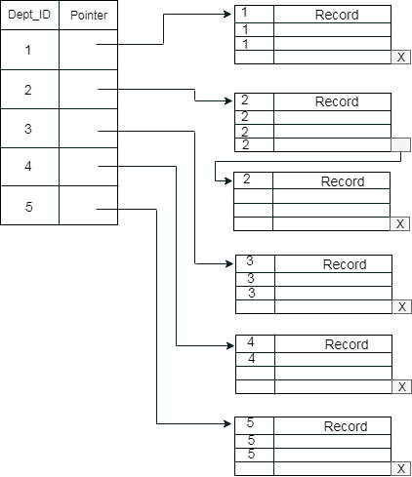
Clustering Index

Slide 17
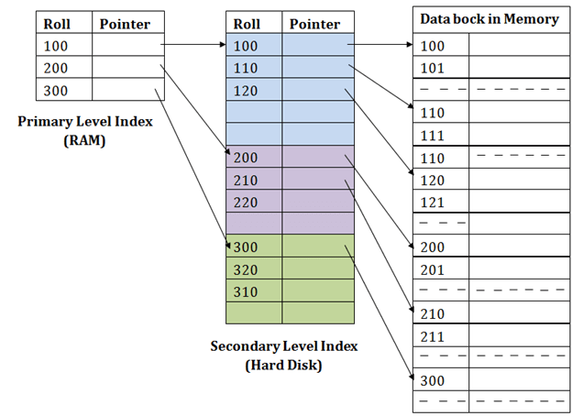
Secondary Index

Slide 18
Thank You

